Slide 1
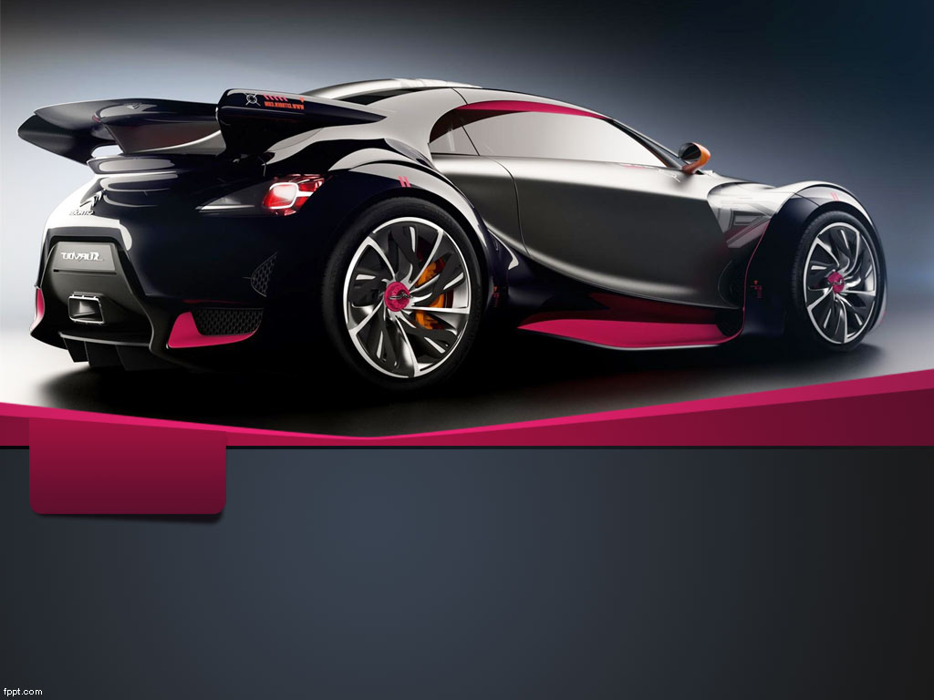
Electronic Shop Practice ECE 3100 Department of Electrical & Computer Engineering Rajshahi University of Engineering & Technology
Car Counter

Slide 2
Team members Mahbuba Habib (1810026) Deba Priyo Guha(1810027) Md. Alif (1810028)

Slide 3
Outline
Introduction
Language and Libraries
Component
Connection
Project Details
Output
Advantage

Slide 4
Introduction
Car counter is a process which provides accurate count of vehicles that enter or exit in a road or highway. One common approach for this is two rubber tubes laid across carriage way. Besides , it can be done with the help of CCTV. Ours one is the latter approach. Recording a video, we processed it with object detection algorithm and count the number of cars.

Slide 5
Languages and Library
Python
OpenCV (Open Source Computer Vision Library)
NumPy

Slide 6
Components
Hardware:
Raspberry Pi
Raspberry Pi Camera Module
Monitor, Mouse, Keyboard
Software:
Visual Studio Code
VNC Viewer

Slide 7
Procedure
* Record the video of a road with Camera Module.
* Track the vehicles with OpenCV.
* Process their images.
* Count and display their numbers.

Slide 8
Object Detection Algorithm
Object detection is a technique of computer vision that identifies an object from an image or video file. It refers to the potential of computer and software systems to locate objects in an image/scene and identify each object. We used OpenCV as image processing library. It is designed to solve computer vision problems.

Slide 9
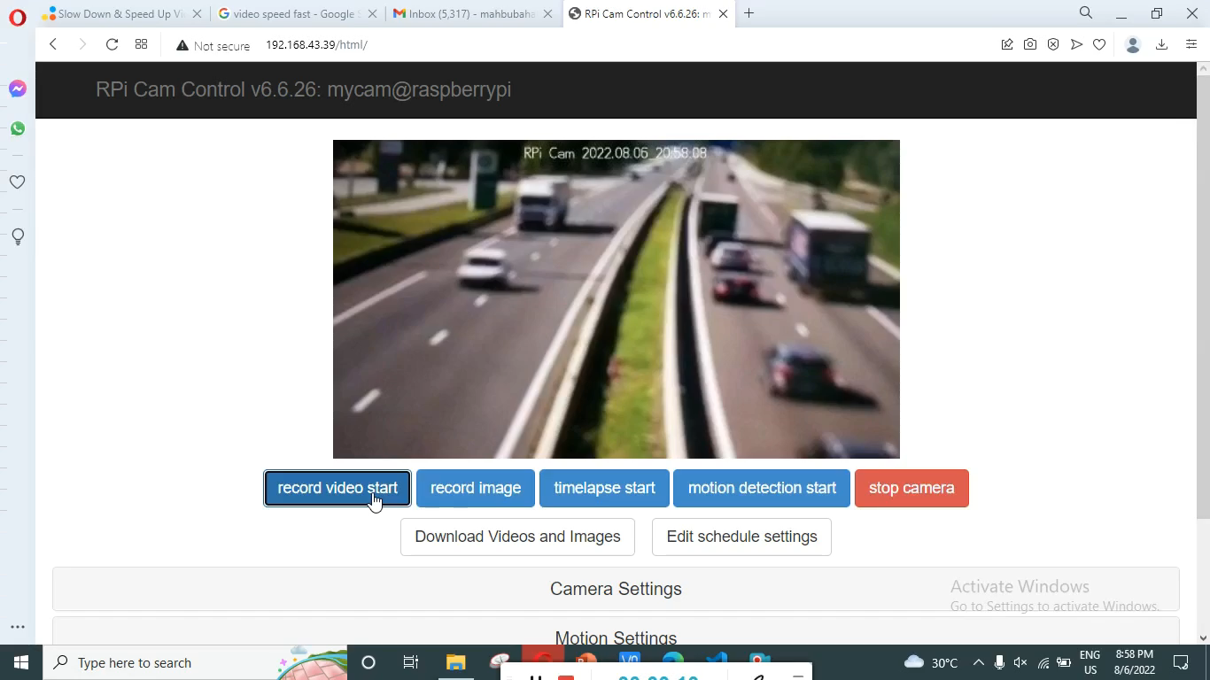
Camera Output

Slide 10
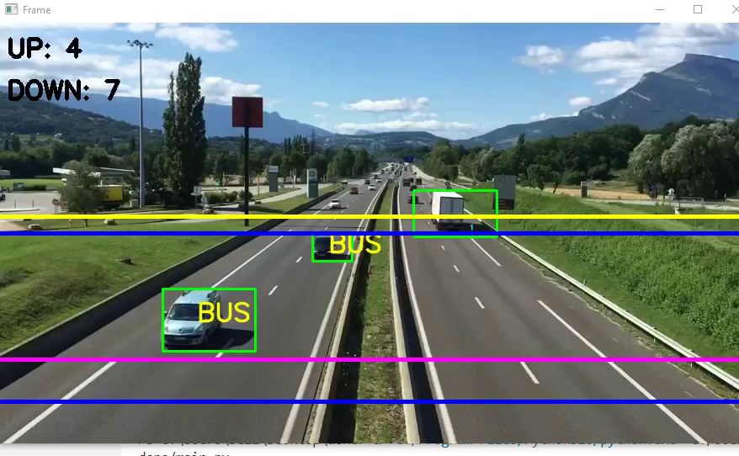
Detect Cars

Slide 11
Advantage
Helps traffic police
Maintaining records
Traffic surveillance control

